Slide 1



How to
CHECK
your invoice/ document status in Tungsten Portal
FOLLOW
THESE STEPS

Slide 2

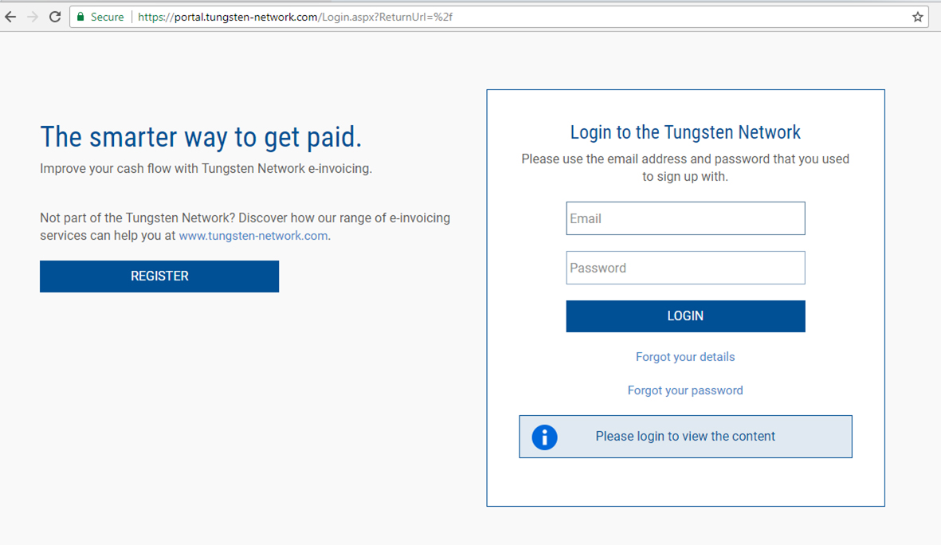

https://portal.tungsten-network.com/Login.aspx?ReturnUrl=%2f
Enter your login ID
Enter your password
STEP 01:
Login to Tungsten Network portal with your login credentials
BACK
NEXT

Slide 3
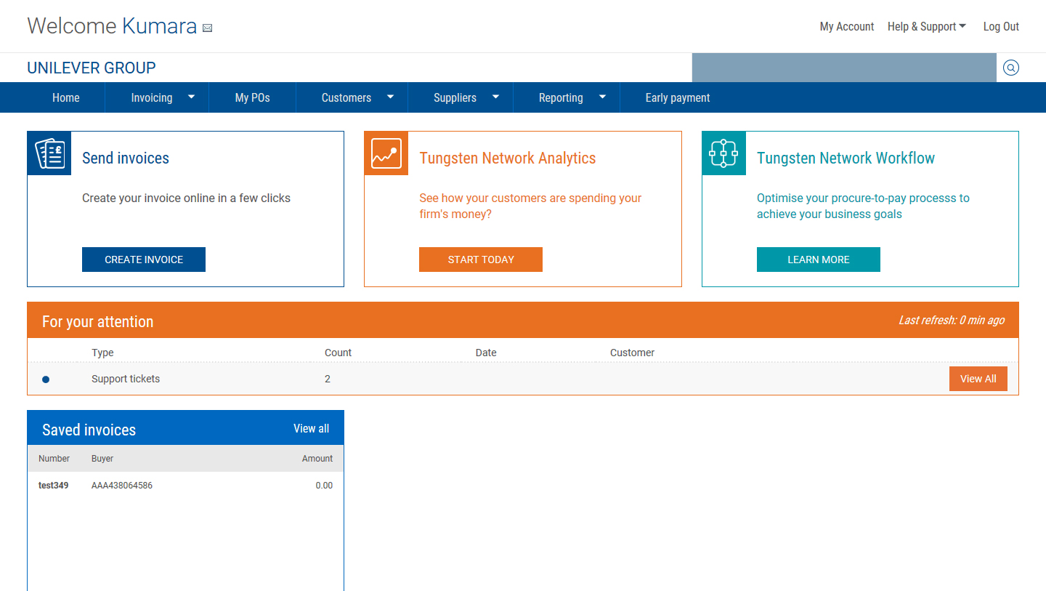
Once you login, the below homepage will be displayed.
To check your invoice status please use the quick search option
https://portal.tungsten-network.com/Login.aspx?ReturnUrl=%2f
Enter the invoice number you want to search
Click on Search
STEP 02:
Click on “Search” and insert the invoice number to check the status of this document
BACK
NEXT

Slide 4
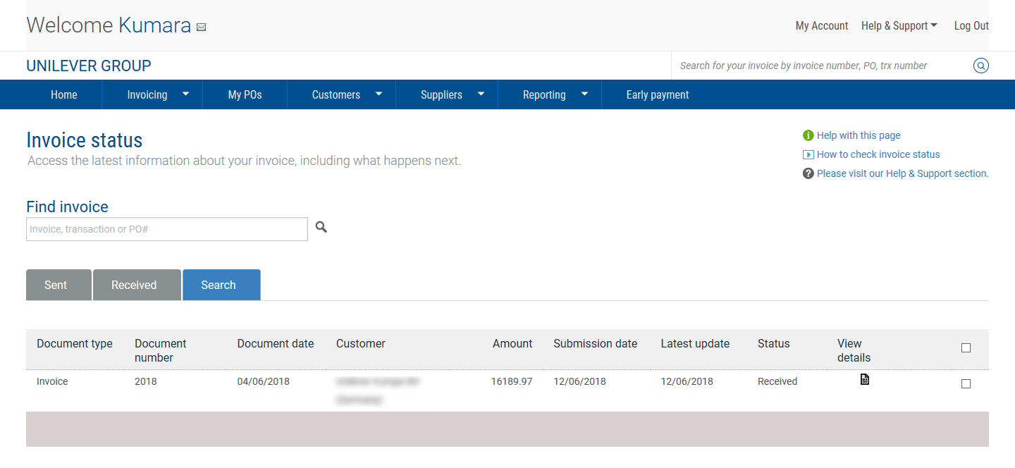
Document amount
Document status
Document type
Document number
Document date
STEP 03:
On the search result page, click on the file icon under “View details”
BACK
NEXT

Slide 5
Document
STATUS
Definitions

Slide 6
Understanding Tungsten Document Status
Sent
  Document is prepared and is pending validation by Tungsten Network
If you do not see the document status progressing or if the document is becoming overdue, please raise a ticket with Unilever Accounts Payable HelpDesk.
How to raise a ticket?
Link: How to raise a query via Tungsten Network
Accepted
  Document has been successfully validated by Tungsten and is ready to be sent to Unilever (Customer)
Not yet reached Unilever
Electronic Invoice
Delivered
  Document has been sent to Unilever and is awaiting confirmation from Unilever
Received
  Document has been received by Unilever and is being processed
Rejected
  Document has been rejected by Unilever
Reached Unilever
Exception
  Document is pending Unilever action
Optional status
Paper & Electronic Invoice
Approved
  Document has been approved and is ready for payment
Paid
  Document has been paid

Slide 7
Understanding Tungsten Document Status
Delivered means the document has been sent out from Tungsten to Unilever and waiting for confirmation from Unilever that the document has reached Unilever
Received, means the document has been received by Unilever and is being processed.
In case the status has not changed, and the document will become due soon, please raise a ticket with Unilever Accounts Payable HelpDesk.
Approved, means the document has been approved by Unilever and will be paid as per the payment due date.
In case you do not agree with the due date displayed on the portal, please contact your Unilever Buyer.
If the invoice is not paid on the due date, please raise a ticket with Unilever Accounts Payable HelpDesk.
Paid, means the document has been paid.
In case you have not received the payments, please raise a ticket with Unilever Accounts Payable HelpDesk.
Rejected, means the document has been rejected and the rejection reason is provided under the Comment and the Additional Comment sections.
If you have not received the rejection email from Unilever or you need further clarifications, please raise a ticket with Unilever Accounts Payable HelpDesk.
How to raise a ticket?
Link: How to raise a query via Tungsten Network
Exception, means the document is pending for action or clarification with Unilever.
In case you see an email address on the document status, you should contact that person for clarification. If you do not see any email address, please raise a ticket with Unilever Accounts Payable HelpDesk.

Slide 8
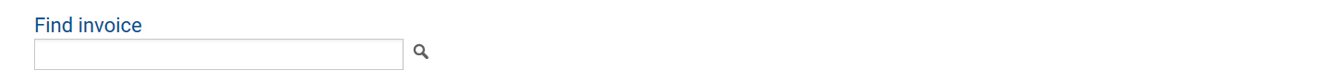
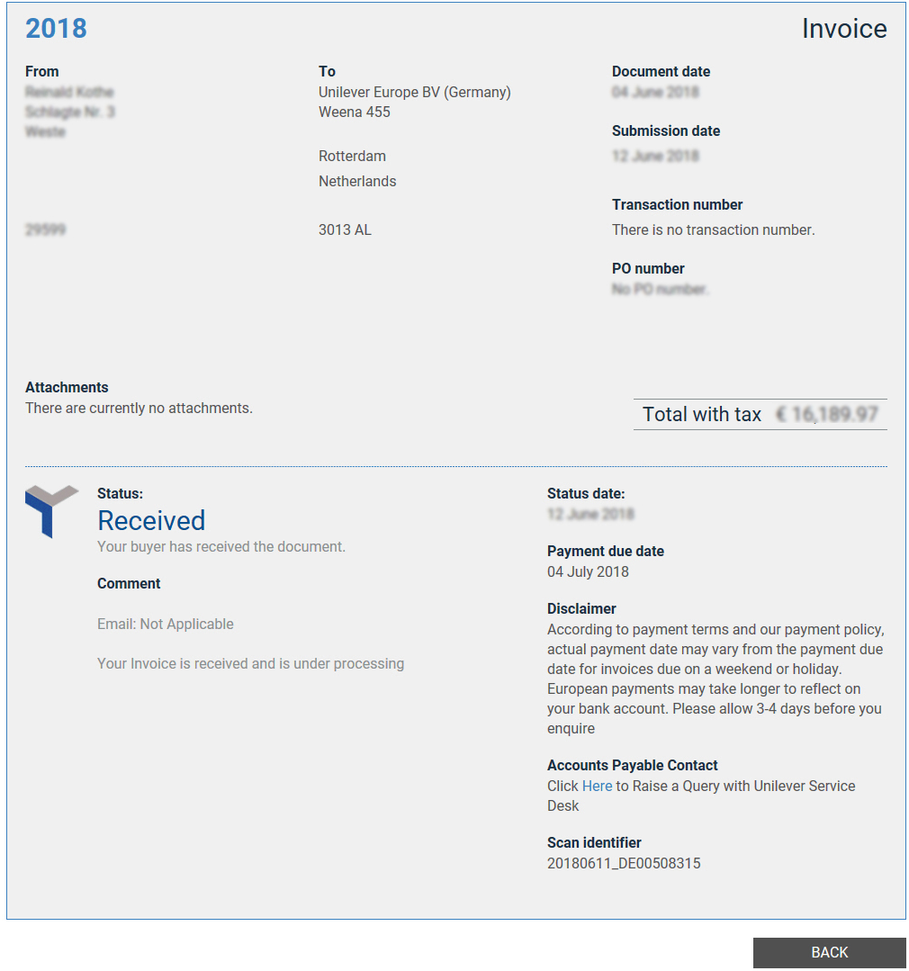
Payment due date as per Unilever
Received, means the document has been received by Unilever and is being processed.
In case the status has not changed, and the document will become due soon, please raise a ticket with Unilever Accounts Payable HelpDesk.
How to raise a ticket?
Link: How to raise a query via Tungsten Network
BACK
NEXT

Slide 9
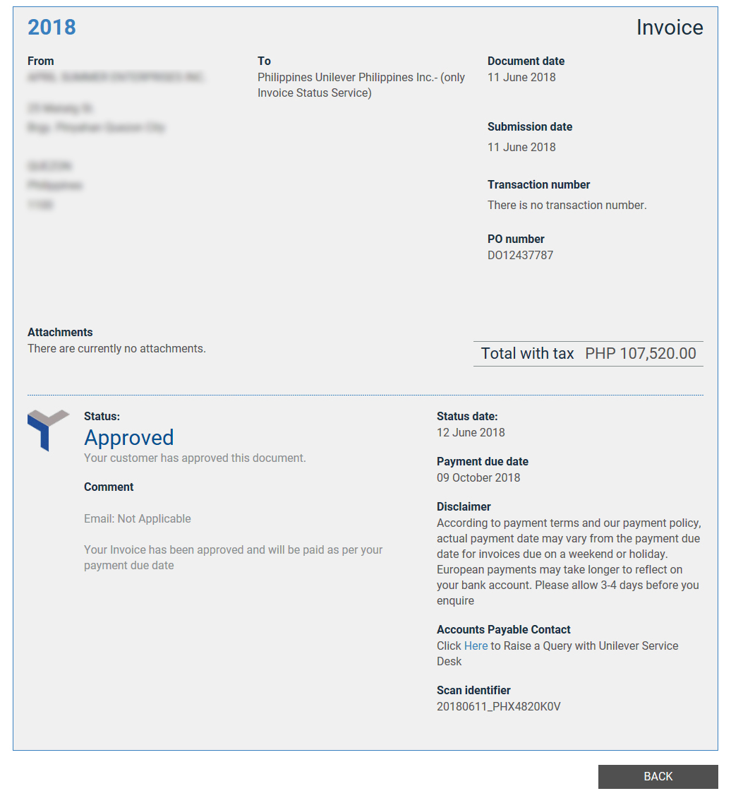
Payment due date as per Unilever
Approved, means the document has been approved by Unilever and will be paid as per the payment due date.
In case you do not agree with the due date displayed on the portal, please contact your Unilever Buyer.
If the invoice is not paid on the due date, please raise a ticket with Unilever Accounts Payable HelpDesk.
How to raise a ticket?
Link: How to raise a query via Tungsten Network
BACK
NEXT

Slide 10
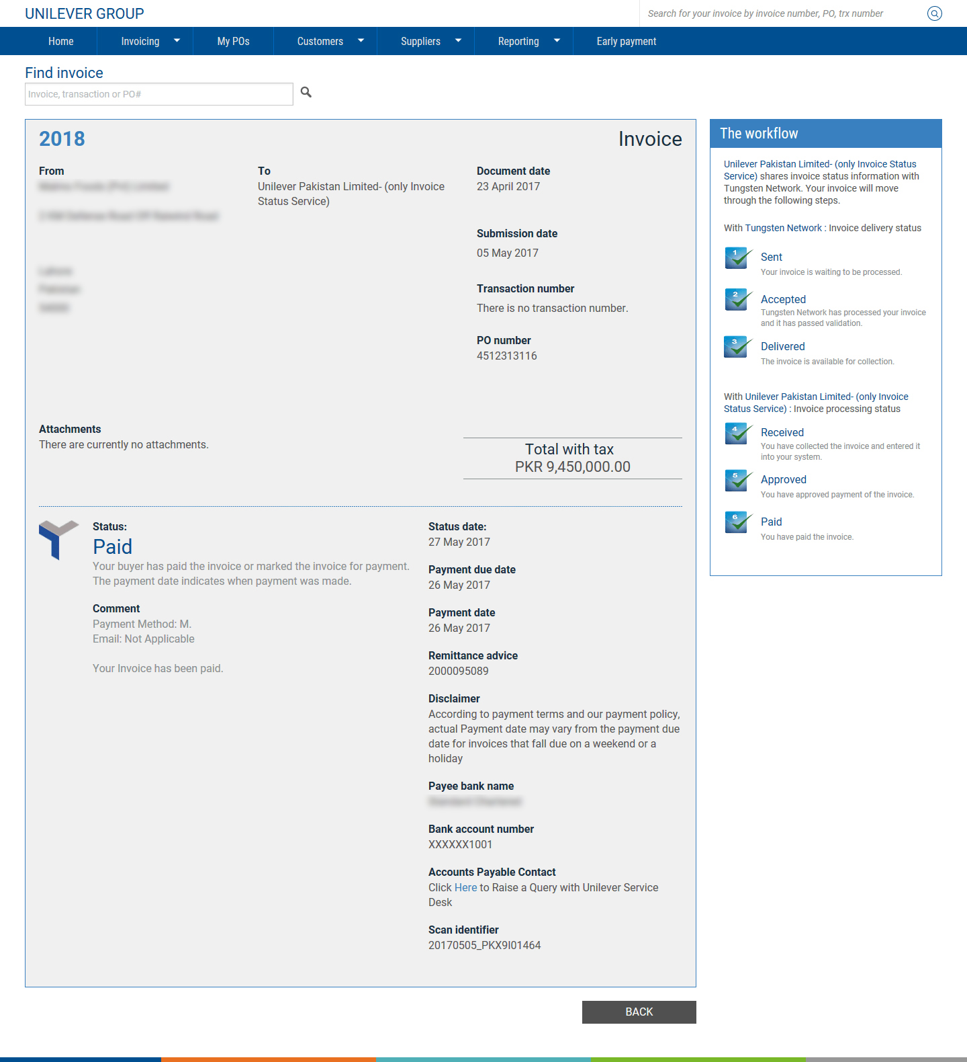

Payment due date as per Unilever
Payment date as per Unilever
Remittance advice number
In case of cheque payment, bank details are not visible.
Paid, means the document has been paid.
In case you have not received the payment, please raise a ticket with Unilever Accounts Payable HelpDesk.
How to raise a ticket?
Link: How to raise a query via Tungsten Network
BACK
NEXT

Slide 11
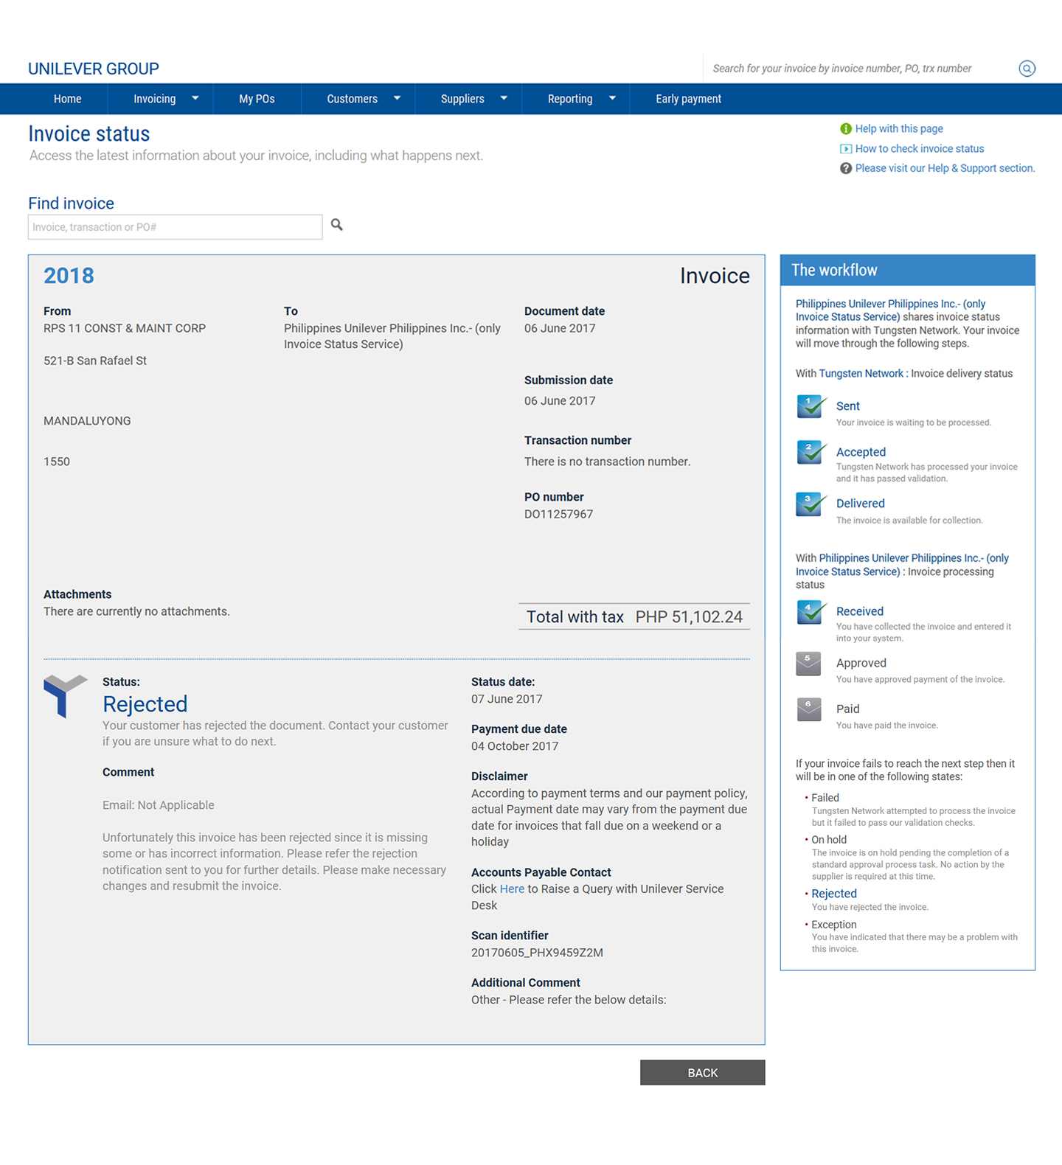
Rejection reason description (part 1)
Rejected, means the document has been rejected and the rejection reason is provided under the Comment and the Additional Comment sections.
If you have not received the rejection email from Unilever or you need further clarifications, please raise a ticket with Unilever Accounts Payable HelpDesk.
How to raise a ticket?
Link: How to raise a query via Tungsten Network
Rejection reason description (part 2)
Please refer to below details
BACK
NEXT

Slide 12
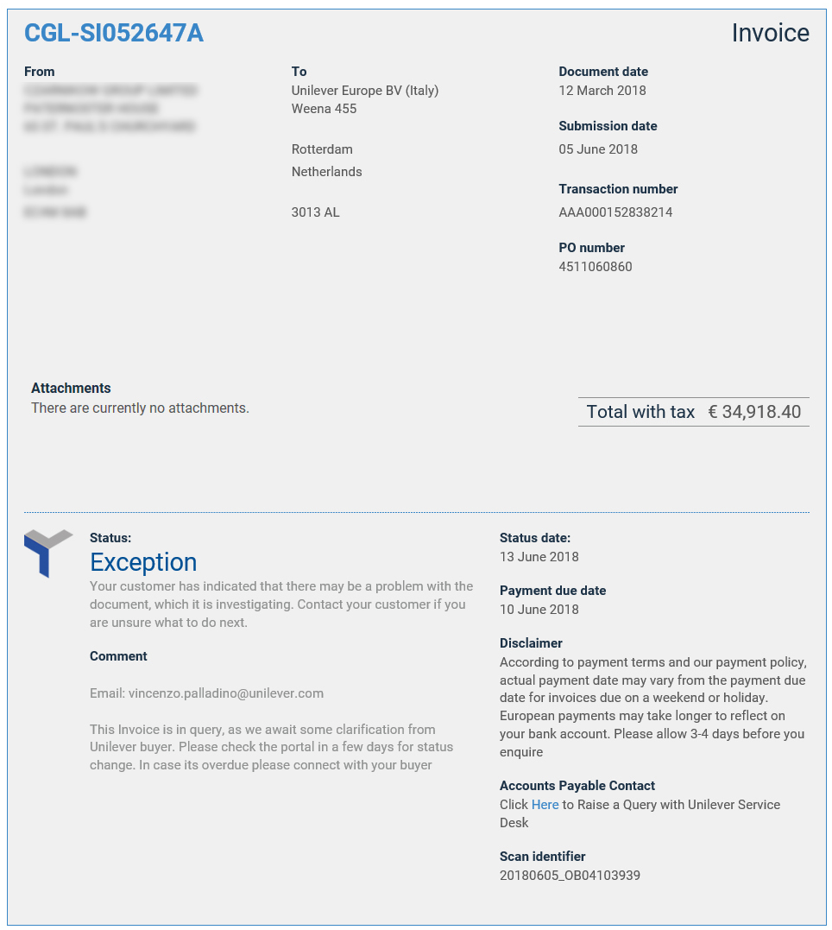
Action pending with Unilever. Contact the Unilever person as per the email address
Exception, means the document is pending for action or clarification with Unilever.
In case if you see an email address on the document status, you should contact that person for clarification. If you do not see any email address, please raise a ticket with Unilever Accounts Payable HelpDesk.
How to raise a ticket?
Link: How to raise a query via Tungsten Network
Only in case the invoice is overdue, you can view Unilever email address with whom the action is pending for you to follow up. Due to legal restrictions, Unilever email address is not displayed in Germany, Austria and Switzerland.
BACK
NEXT

Slide 13
How to
VIEW
remittance advice in Tungsten Portal

Slide 14
Once you login, below homepage would be displayed. To check the document status use the quick search option:
https://portal.tungsten-network.com/Login.aspx?ReturnUrl=%2f
Enter the Remittance advice number you want to search
Click on Search
STEP 02:
Click on “Search” to check the list of invoices paid as per the remittance advice
BACK
NEXT

Slide 15
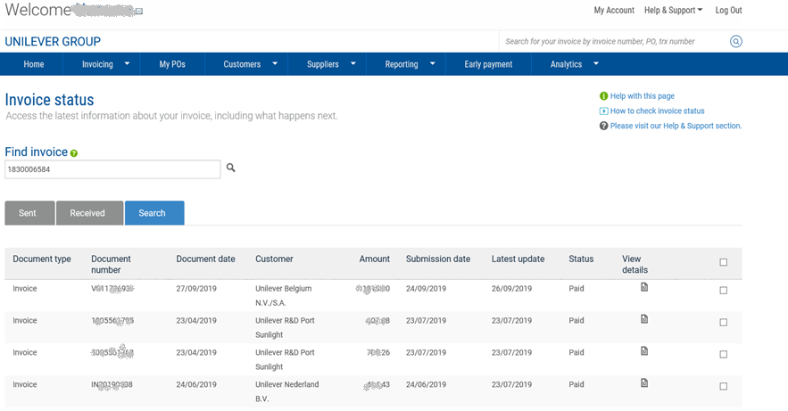
Remittance advice number
Documents paid
Status
Document amount
STEP 03:
Search result will display the list of documents paid with this remittance advice
Document number
Document type
BACK
NEXT

Slide 16
Thank You

